Slide 1
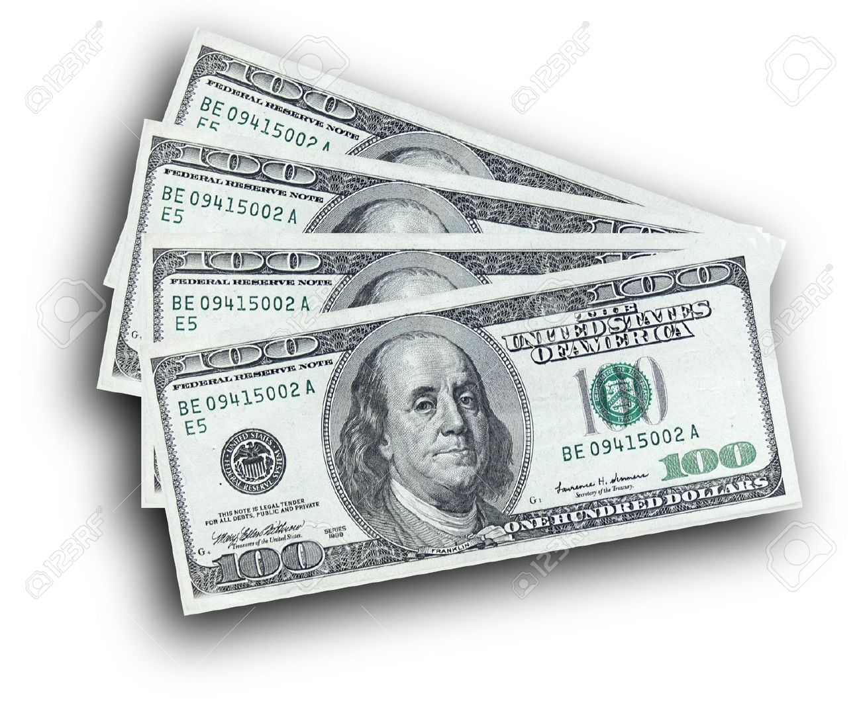
Bank note authentication
Presented By:
Jinesh Kachhara (10414040)
Guided By:
Professor Mahmoud Daneshmand

Slide 2
Table of contents
Introduction
CRISP
Business Understanding Phase
Data Understanding Phase
Data Preparation Phase
Modelling Phase
Evaluation Phase
Deployment Phase
Conclusion

Slide 3
Introduction
Banknotes are currencies used to carry-out financial activities and are every countries asset which every nation wants it (bank-note) to be genuine. Lot of miscreants induces fake notes into the market which resemble exactly the original note. Hence, there is a need for an efficient authentication system which predicts accurately whether the given note is genuine or not.
Exhaustive experiments have been conducted using different machine learning techniques and found that Decision trees are effective for banknote authentication which efficiently classifies a given banknote data.
The rules given by Decision Tree are also tested and found that they are accurate enough to be used for prediction.

Slide 4
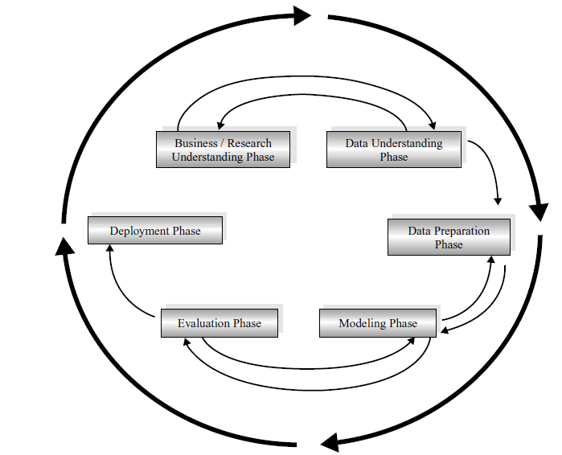
CROSS-INDUSTRY STANDARD PROCESS (CRISP–DM)
Business understanding phase
Data understanding phase
Data preparation phase
Modeling phase
Evaluation phase
Deployment phase

Slide 5
Business Understanding
Profound Question: To determine whether a currency note is genuine or fake.
Goal: Use data mining techniques like classification algorithms, to classify notes as real or fake and derive rules for the same.
Accomplishments: The derived rules will ease the job in identifying the notes. These rules can be used by Treasury department of nation, police department, crime branch, corporate offices, banks or any organization which has image scanning machine and deals with a lot of hard currency in their life.

Slide 6
Data Understanding
Data Source: Data were extracted from images that were taken from genuine and forged banknote-like specimens. For digitization, an industrial camera usually used for print inspection was used. The final images have 400x 400 pixels. Due to the object lens and distance to the investigated object gray-scale pictures with a resolution of about 660 dpi were gained. Wavelet Transform tool were used to extract features from images.
Owner of database: Volker Lohweg (University of Applied Sciences, Ostwestfalen-Lippe, volker.lohweg '@' hs-owl.de)
Donor of database: Helene DÃ¶rksen (University of Applied Sciences,
Ostwestfalen-Lippe, helene.doerksen '@' hs-owl.de)
Data was obtained from: UCI Machine Learning
http://archive.ics.uci.edu/ml/datasets/banknote+authentication#

Slide 7
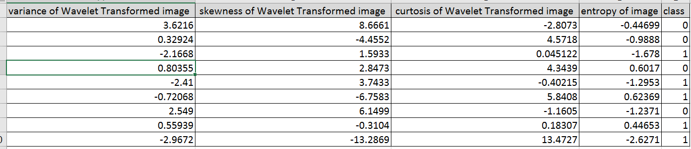
Data Understanding
Data source detail:
Number of Instances: 1372
Number of Variables: 5
Sample data

Slide 8
Data Understanding
Input Variables:
1. variance of Wavelet Transformed image (continuous)
2. skewness of Wavelet Transformed image (continuous)
3. curtosis of Wavelet Transformed image (continuous)
4. entropy of image (continuous)
5. class (integer)
Output Variables:
5. Class(Integer). It will show us that whether the currency note is genuine or not.
0 – Fake Notes
1 – Real Notes
All these are properties of an image

Slide 9
Data Preparation
Data Clean:
Handle Missing values & Identify outliers:
No missing value was found.
No outliers have been found in origin data.
Look for variables that might need transformation.
No variables that need transformation.
Variable selection: Select variable appropriate for analysis.
No irrelevant variables.

Slide 10
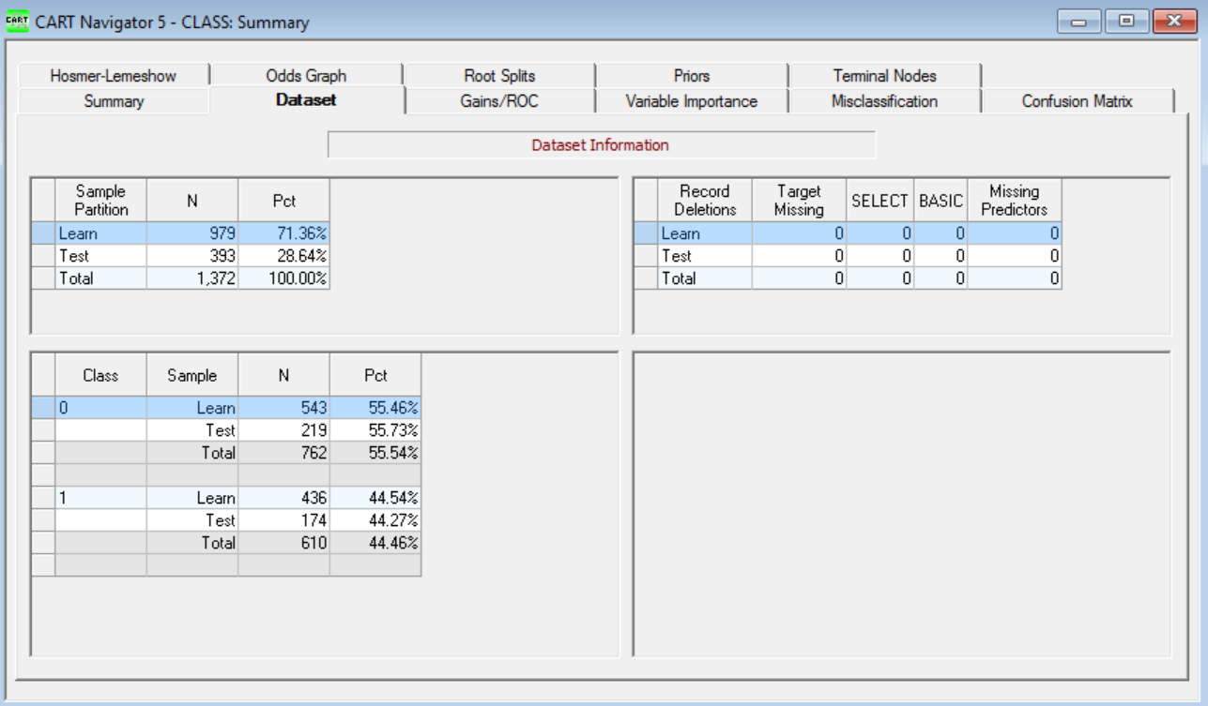
Data Preparation
Data Division:
After data clean, the data set consisting of 1372 records is divided into 2 sets.
Training data set: 71%of the data (979 records) is used to develop the model.
Testing data: 29% of the data (393 records) is used to evaluate the model.

Slide 11
Data Modelling
The next step is to select the appropriate Modeling technique.
We will use one of the Machine Learning Algorithms for our case.
Why Machine Learning Algorithms?
ML derives rules from data.
It takes the selected data and finds the relationship between dependent and independent variables.
Using ML the relationship can be described as a decision tree, a rule, a chart, or an equation.
ML Algorithms answer the question: “What is the pattern that matches this data?”

Slide 12
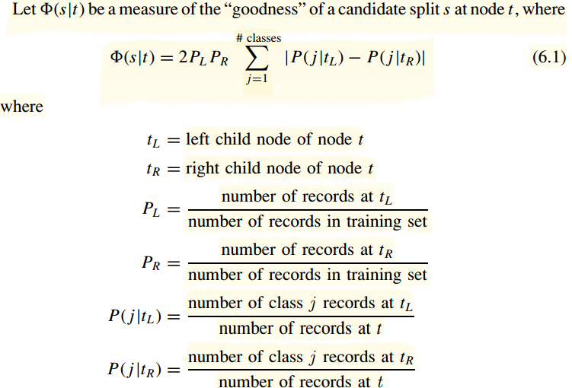
Data Modelling
Which ML Technique?
The main objective here is to classify the Notes into real notes and fake notes and derive rules for the same.
So the approach of Recursive Partitioning best fits here, since it splits the data into finer and finer subsets(recursively) resulting in a decision tree.
Also since the target variable is categorical (1 – Real notes / 0 – Fake notes) and is not continuous, Classification Trees is the right choice.
Hence the CART Algorithm seems to be appropriate choice for this problem. CART recursively partitions the data into subsets with similar value of target variable.

Slide 13
Data Modelling
Which software?
Salford Systems: Salford Systems provides data mining and choice modeling software. It is a highly accurate and ultra-fast platform for developing predictive, descriptive, and analytical models from databases of any size, complexity, or organization.
Salford SPM automation accelerates the process of model building by conducting substantial portions of the model exploration and refinement process for the analyst.

Slide 14
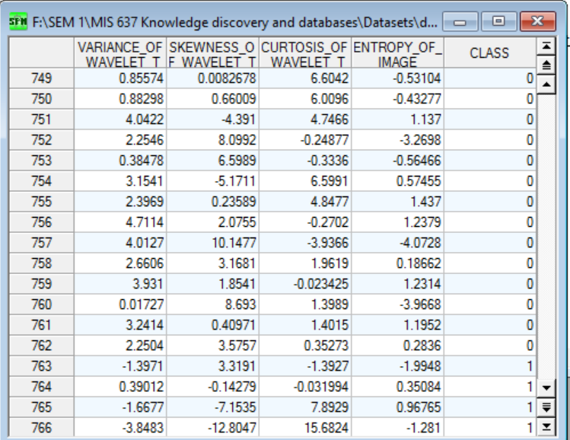
Data Modelling
Selecting the file and viewing the Training Data file

Slide 15
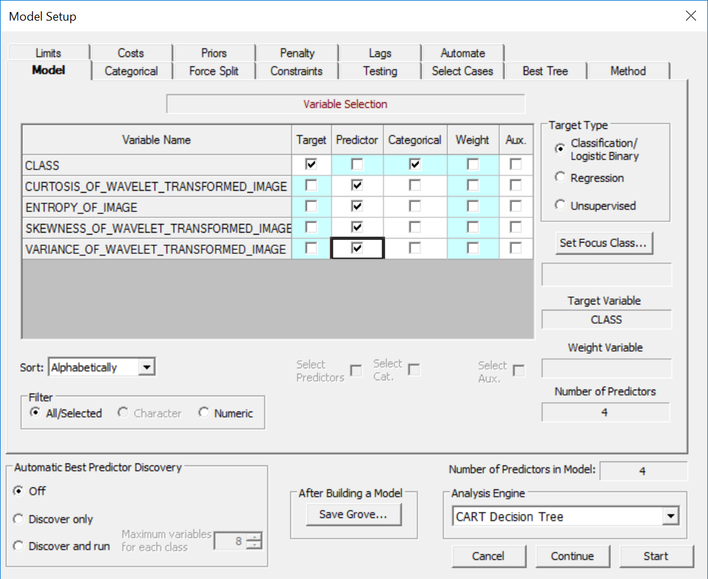
Data Modelling
Setting up the Model
Selecting the Target variable and the Predictor variables. After the Model is set we can begin the CART analysis by clicking on Start. This will generate the Decision Tree.

Slide 16
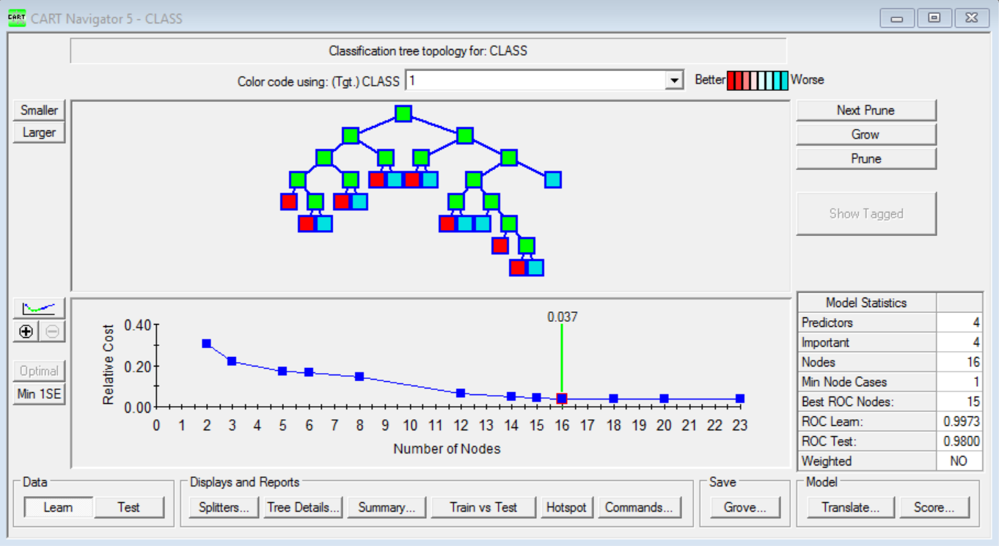
Data Modelling
Classification Tree Topology for TARGET variable.
This is the view of the optimal tree which has the best performance. Number of nodes in the tree equal to 16.

Slide 17
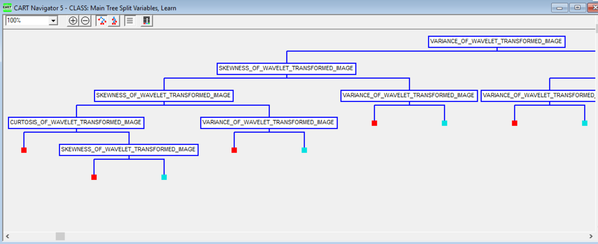
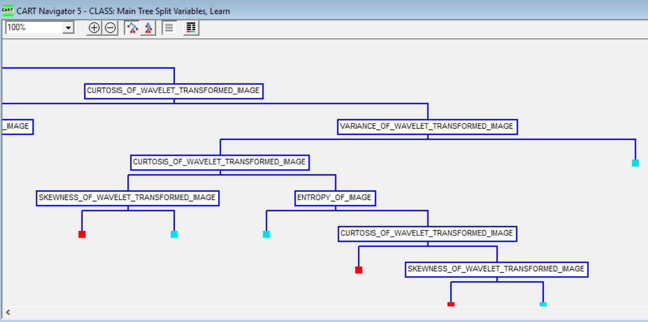
Data Modelling

Slide 18
CART Rules
Terminal node | Antecedent | Consequent
Node 1 | if(VARIANCE_OF_WAVELET_TRANSFORMED_IMAGE <= 0.31155 && SKEWNESS_OF_WAVELET_TRANSFORMED_IMAGE <= 5.86535 && CURTOSIS_OF_WAVELET_TRANSFORMED_IMAGE <= 6.21865 ) | Real Note
Node 2 | if(VARIANCE_OF_WAVELET_TRANSFORMED_IMAGE <= 0.31155 && CURTOSIS_OF_WAVELET_TRANSFORMED_IMAGE > 6.21865 && SKEWNESS_OF_WAVELET_TRANSFORMED_IMAGE <= -3.16705 ) | Real Note
Node 3 | if(VARIANCE_OF_WAVELET_TRANSFORMED_IMAGE <= 0.31155 && CURTOSIS_OF_WAVELET_TRANSFORMED_IMAGE > 6.21865 && SKEWNESS_OF_WAVELET_TRANSFORMED_IMAGE > -3.16705 && SKEWNESS_OF_WAVELET_TRANSFORMED_IMAGE <= 5.86535) | Fake Note
Node 4 | if(SKEWNESS_OF_WAVELET_TRANSFORMED_IMAGE > 5.86535 && SKEWNESS_OF_WAVELET_TRANSFORMED_IMAGE <= 8.18500 && VARIANCE_OF_WAVELET_TRANSFORMED_IMAGE <= -3.00315) | Real Note
Node 5 | if(SKEWNESS_OF_WAVELET_TRANSFORMED_IMAGE > 5.86535 && SKEWNESS_OF_WAVELET_TRANSFORMED_IMAGE <= 8.18500 && VARIANCE_OF_WAVELET_TRANSFORMED_IMAGE > -3.00315 && VARIANCE_OF_WAVELET_TRANSFORMED_IMAGE <= 0.31155 ) | Fake Note
Node 6 | if(SKEWNESS_OF_WAVELET_TRANSFORMED_IMAGE > 8.18500 && VARIANCE_OF_WAVELET_TRANSFORMED_IMAGE <= -4.11600 ) | Real Note
Node 7 | if(SKEWNESS_OF_WAVELET_TRANSFORMED_IMAGE > 8.18500 && VARIANCE_OF_WAVELET_TRANSFORMED_IMAGE > -4.11600 && VARIANCE_OF_WAVELET_TRANSFORMED_IMAGE <= 0.31155 ) | Fake Note

Slide 19
CART Rules
Terminal node | Antecedent | Consequent
Node 8 | If (CURTOSIS_OF_WAVELET_TRANSFORMED_IMAGE <= -3.95890 && VARIANCE_OF_WAVELET_TRANSFORMED_IMAGE > 0.31155 && VARIANCE_OF_WAVELET_TRANSFORMED_IMAGE <= 2.95365 ) | Real Note
Node 9 | if(CURTOSIS_OF_WAVELET_TRANSFORMED_IMAGE <= -3.95890 && VARIANCE_OF_WAVELET_TRANSFORMED_IMAGE > 2.95365 ) | Fake Note
Node 10 | if(VARIANCE_OF_WAVELET_TRANSFORMED_IMAGE > 0.31155 && VARIANCE_OF_WAVELET_TRANSFORMED_IMAGE <= 1.59220 && CURTOSIS_OF_WAVELET_TRANSFORMED_IMAGE > -3.95890 && CURTOSIS_OF_WAVELET_TRANSFORMED_IMAGE <= -2.27220 && SKEWNESS_OF_WAVELET_TRANSFORMED_IMAGE <= 5.56015 ) | Real Note
Node 11 | if(VARIANCE_OF_WAVELET_TRANSFORMED_IMAGE > 0.31155 && VARIANCE_OF_WAVELET_TRANSFORMED_IMAGE <= 1.59220 && CURTOSIS_OF_WAVELET_TRANSFORMED_IMAGE > -3.95890 && CURTOSIS_OF_WAVELET_TRANSFORMED_IMAGE <= -2.27220 && SKEWNESS_OF_WAVELET_TRANSFORMED_IMAGE > 5.56015 ) | Fake Note
Node 12 | if(VARIANCE_OF_WAVELET_TRANSFORMED_IMAGE > 0.31155 && VARIANCE_OF_WAVELET_TRANSFORMED_IMAGE <= 1.59220 && CURTOSIS_OF_WAVELET_TRANSFORMED_IMAGE > -2.27220 && ENTROPY_OF_IMAGE <= 0.22994 ) | Fake Note
Node 13 | if(VARIANCE_OF_WAVELET_TRANSFORMED_IMAGE > 0.31155 && VARIANCE_OF_WAVELET_TRANSFORMED_IMAGE <= 1.59220 && ENTROPY_OF_IMAGE > 0.22994 && CURTOSIS_OF_WAVELET_TRANSFORMED_IMAGE > -2.27220 && CURTOSIS_OF_WAVELET_TRANSFORMED_IMAGE <= 0.32402) | Real Note

Slide 20
CART Rules
Terminal node | Antecedent | Consequent
Node 14 | if(VARIANCE_OF_WAVELET_TRANSFORMED_IMAGE > 0.31155 && VARIANCE_OF_WAVELET_TRANSFORMED_IMAGE <= 1.59220 && ENTROPY_OF_IMAGE > 0.22994 && CURTOSIS_OF_WAVELET_TRANSFORMED_IMAGE > 0.32402 && SKEWNESS_OF_WAVELET_TRANSFORMED_IMAGE <= -2.17999 ) | Real Note
Node 15 | if(VARIANCE_OF_WAVELET_TRANSFORMED_IMAGE > 0.31155 && VARIANCE_OF_WAVELET_TRANSFORMED_IMAGE <= 1.59220 && ENTROPY_OF_IMAGE > 0.22994 && CURTOSIS_OF_WAVELET_TRANSFORMED_IMAGE > 0.32402 && SKEWNESS_OF_WAVELET_TRANSFORMED_IMAGE > -2.17999 ) | Fake Note
Node 16 | if(CURTOSIS_OF_WAVELET_TRANSFORMED_IMAGE > -3.95890 && VARIANCE_OF_WAVELET_TRANSFORMED_IMAGE > 1.59220 ) | Fake Note

Slide 21
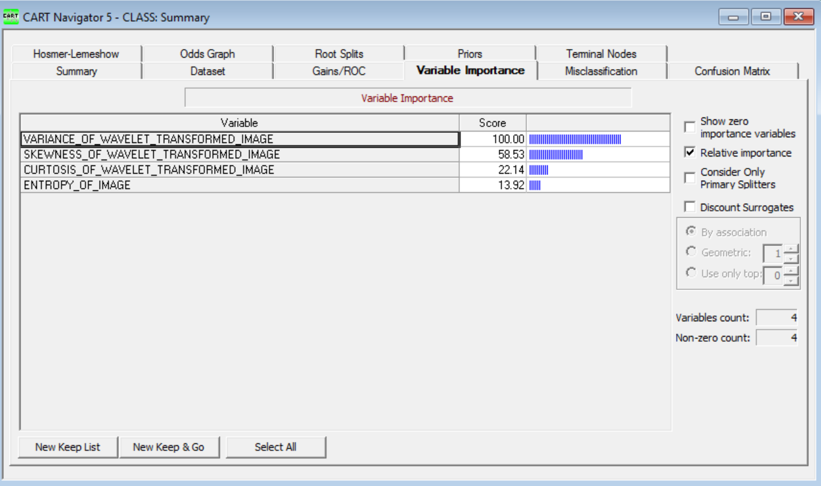
Evaluation
Variance of wavelet transformed image is the most important variable. This means that for a particular image properties of the note always first check for Variance of wavelet transformed image

Slide 22
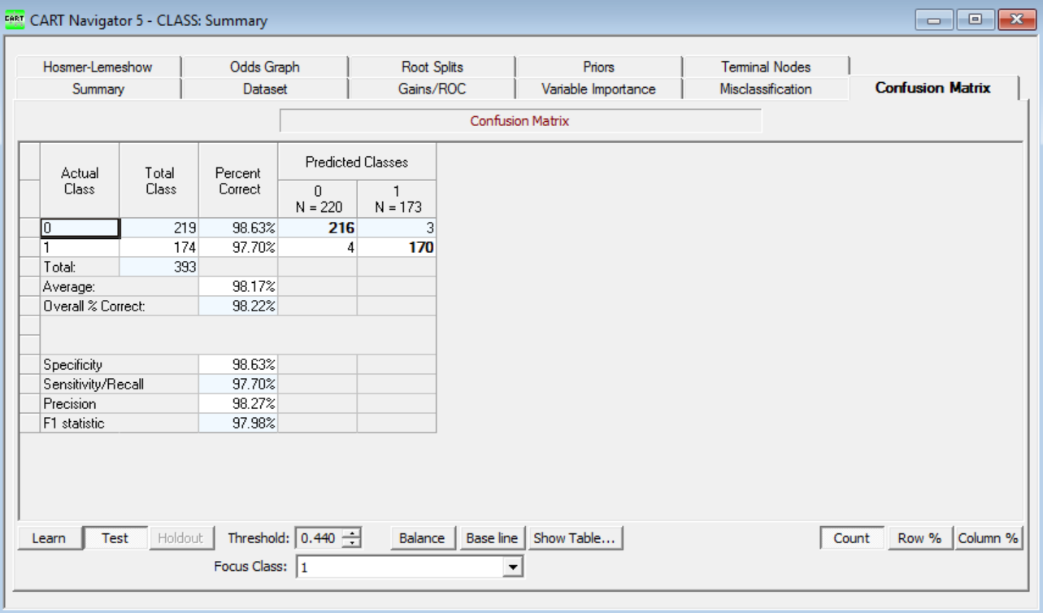
Evaluation
Here we get the overall error on test dataset as 2% so our model is 98% accurate.

Slide 23
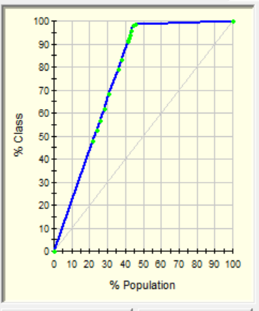
Evaluation
Gains Curve:
This is obtained in Salford Systems
The area under the curve represents the accuracy rate
The Gains curve is simple to read, for instance this curve besides tells if we look at around top 23% of the data, we would capture almost 48% of the real notes( indicated by 1s).

Slide 24
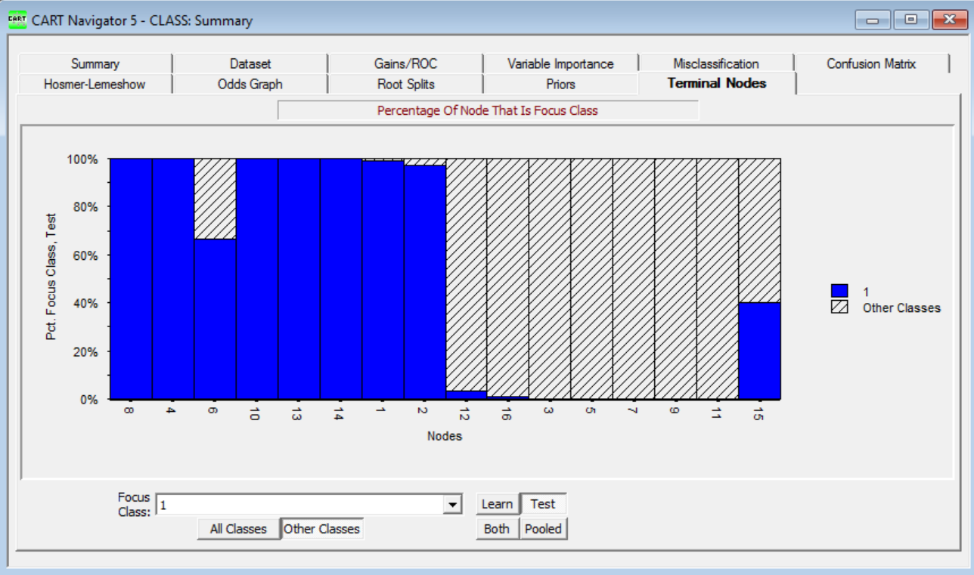
Evaluation
Terminal Nodes Report
This report shows the ability of the Tree’s Terminal nodes to capture the Real notes

Slide 25
Deployment
This is the final phase of the CRISP-DM process. Here we will use the Model created and perform deployment.
Plan: The rules obtained from the terminal nodes can be applied to larger data set to see the impact. The predictions can be made to identify the real notes from the fake notes. CART is a good classification algorithm that gives appropriate results which helps not just the treasure of the nation but also banks and many other corporate sectors.
Action: Simple report of results will be provided and the results will be checked to verify success. The deliverables will be compared against the expected goal as discussed during the Business Understanding phase.
Evaluation, Monitor: Monitoring the prediction rates while comparing with the results from algorithm would make the model more accurate.
Finally the Model execution instructions will be provided to the Treasury department of the nation, banks who can now utilize this model to in eliminating counterfeit note from the market by identifying real or fake notes. This will in turn increase the nations economy, decrease black money.

Slide 26
Conclusion
In conclusion, CART algorithm is a good predictor for binary variables, YES or No type of profound questions.
In this case, Treasury department of the nation, banks etc. can use this model to determine the fake notes from the real ones based on the data obtained.
CRISP is very powerful process for data mining to answer the profound question.
The results show that the Model achieved good prediction success rate of 98% on test dataset which means that 98% are the chances that the bank can predict the fake notes from the authentic ones.

Slide 27
Reference
Dataset:
http://archive.ics.uci.edu/ml/datasets/banknote+authentication#
http://www.stat.cmu.edu/~rnugent/PCMI2016/ProblemSession-7-11.pdf
Software site:
https://www.salford-systems.com/
http://www.studica.com/Salford-Systems/salford-systems-predictive-modeling-suite.html
Other References:
Discovering Knowledge in Data: An Introduction to Data Mining, By Daniel T. Larose
Lecture Notes and Slides

Slide 28
Thank you

